Slide 1
Annual General Meeting
12 October 2023

Slide 2

The Narth & District Village Hall AGM
AGENDA
Minutes of the last meeting
Annual Report 2023
  Review of the year
  Our current situation and looking forward
  Finance report
Discussion time – your chance to ask questions and give your opinion
Elections to the Committee
100 Club draw
Notes:
APOLOGIES: Rachel Widdicks, Steve & Jane Gilliard, Brian & Kay Mahony

Slide 3

Annual Report 2023

Slide 4

Hall Use
Some users didn’t return after COVID but we have some new regular users:
Regular groups using the hall:
  Glade Tavern
  Garden Club
  Narth Singers
  Table Tennis
  Keep Fit
  Pilates
  Brownies
Notes:
Adult ballet dance session

Slide 5
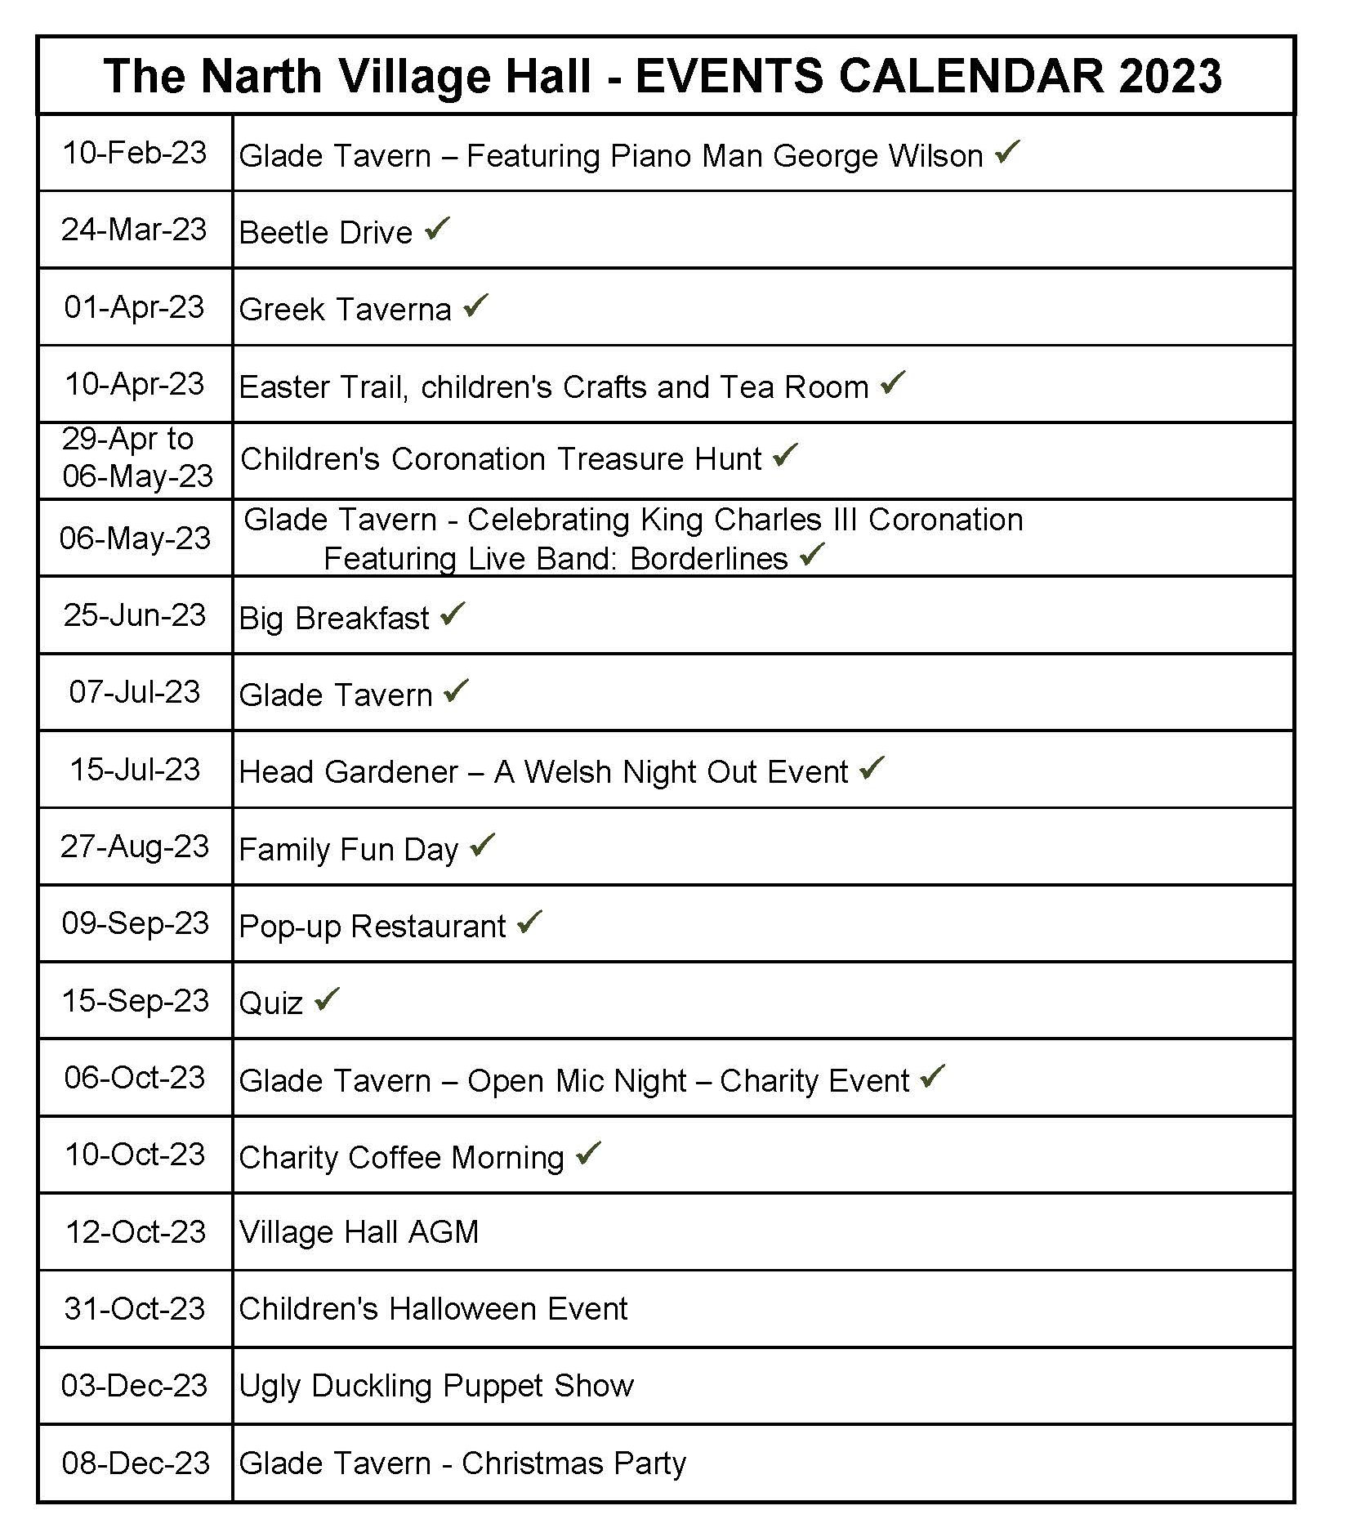
Events
Notes:
Wye Valley Women have a Something Different session on Saturday
Narth Singers Christmas concert 16th December Trellech

Slide 6

Oil Buying Group
Membership costs £8 and last year raised £296 for the hall
79,000 litres of oil ordered in the last 12 months
Average savings were £69 per member (5.6%) amounting to:
    £2,554 for the group
We now even have a member from Trellech!
Notes:
Full details in report

Slide 7



Associations with the hall
Life of Manor Wood Project
Footpath Group
Friends of the 65 Bus
Notes:
Full details in Annual Report

Slide 8

Hall maintenance and improvements
Minor repairs:
  replacement light bulbs
  leaking taps
  faulty handles etc
Garden tidied and maintained
  (with special thanks to Pam Manfield and Gwen Reid)

Slide 9

Planned improvements
Planning has been approved for:
Outside space
New roof over kitchen and ante room (will require grant funding)
  Roof work will include replacement facia boards and guttering
  The cooker hood and extractor will also be replaced during this work
A tender document has been produced and sent out
Stocktake and Clear Out… AMNESTY!
Notes:
Need to complete projects in the right order to prevent abortive work

Slide 10

Planned improvements – to follow
Supplementary heating in the hall
Redecorate
  Main hall
  Ante room
Resurface car park

Slide 11

Volunteers
The hall belongs to the village
  Everyone has a share and a say in its activities
The committee is elected by the residents to run the hall on their behalf
We couldn’t manage without the many other volunteers

Slide 12

Finance Report
2022-2023
Notes:
Main report available – THANK BILL PARNELL

Slide 13
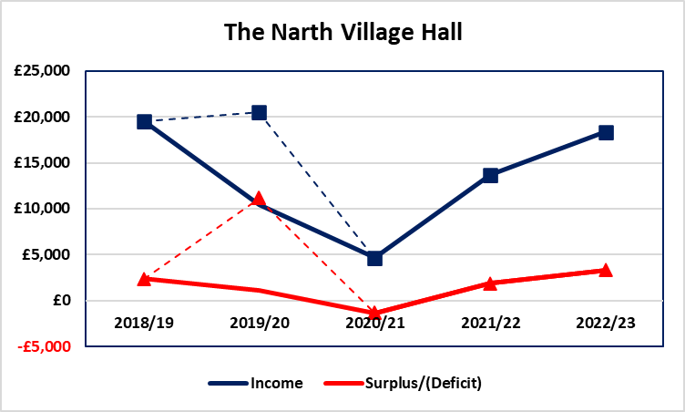
5 Year Performance
COVID

Slide 14

The numbers

Slide 15
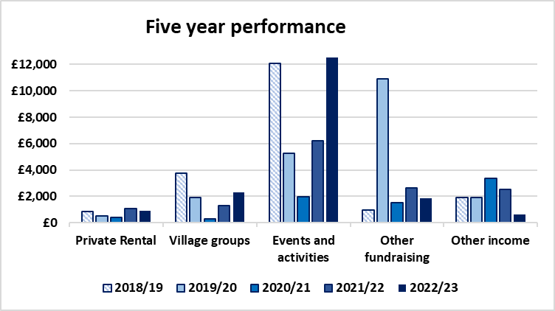
Where the money comes from

Slide 16
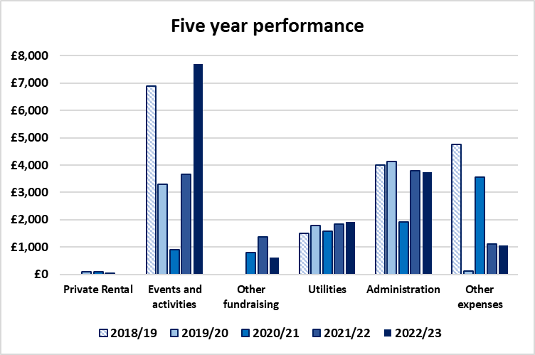
Where the money goes

Slide 17
Events 2022/23

Slide 18

Not just about the money
Events held to support charities – Table-Top Jumble Sale, Big Breakfast and the Quiz
Electricity contract renewal and Smart meter to be installed
Changed the Charity Commission document for the Village Hall – more useable
Grant support from Trellech Community Council
Co-operative bank account set up and operational
Wix account set up to enable web-based payment
Barclays account being run down
Overall cash balance at end of Sept 2023
£38,225

Slide 19
Which sounds a lot….but
The Hall is showing its age so
Now have planning approval for a revised roofline, patio and pergola outside the hall and timber cladding the front
Tender document has been prepared and sent out to three builders, two already declined as booked out until mid 2025
Need to identify further options to get three responses
Grant application to fund work
In the meantime (exciting stuff)
Shortly be having a skip to get rid of accumulated “Stuff”
Septic tank needs emptying

Slide 20
A reminder
Key numbers for 2022/23

Slide 21

End with the Thanks
Steve Gilliard – for his invaluable help and advice in pulling together the tender documents
Marilyn Dunkelman – for her patience every time she receives a letter from a Village Hall supplier
Trisha Porter - for inspecting and signing off the accounts for 2021/22 and who I hope will do it again this year

Slide 22

Your Turn
Any questions or comments?

Slide 23

Electing the Committee

Slide 24
Thank you to our retiring members
Wen Atkinson
Fiona Harling
Notes:
Wen has been our H & S expert for many years as well as an enthusiastic and determined events organiser and co-Ordinator
Fiona has done much to improve the integration of Pen-y-Fan residents into hall events and is a crafting queen

Slide 25
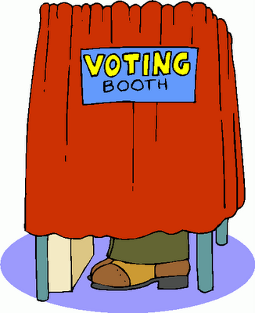
Election of the committee
9 to 12 committee members are elected each year by the village
Representative members can be appointed by the Community Council (TUCC) and the Church Council (PCC)
We’ll now vote as a block for the continuing members…

Slide 26
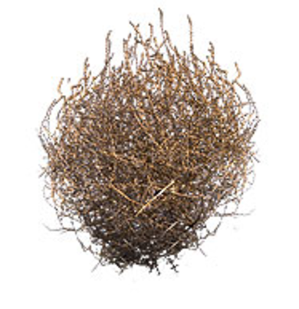

New Committee
Standing for re-election
  Clark Atkinson (chair)
  Dave Lloyd (treasurer)
  Anna Brown (secretary)
  Rachel Widdicks (safeguarding)
  Judi Smowton (bookings & housekeeping)
  Matthew Sadler
  Luisa Sadler
  Lisa Dorel
  Alison Arnell
  Mark Arnell
Nominations
Richard Smowton (health & safety)
Marcus Harling

Slide 27

100 Club draw

Slide 28

100 Club
Total of 69 members at end of year September 2022
Total income: £828
Prize money paid out: £621
Money raised for Village Hall funds: £207
We now have 80 members…
Can we make it to 100 this year?

Slide 29
100 Club prize winners

Slide 30
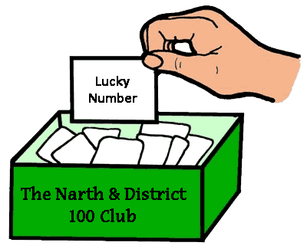
The 100 Club Draw
Notes:
Committee members – quick meeting to arrange meeting schedule

Slide 31
Thank you

